Slide 1
7COM1025 Programming for Software Engineers
7COM1025 Programming for Software Engineers
Design Pattern (2), Spring Framework (IoC)
Dr Hui Cheng
Email: h.cheng2@herts.ac.uk

Slide 2
Design Pattern (2)

Slide 3

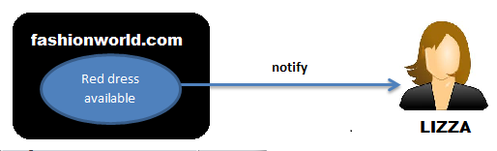
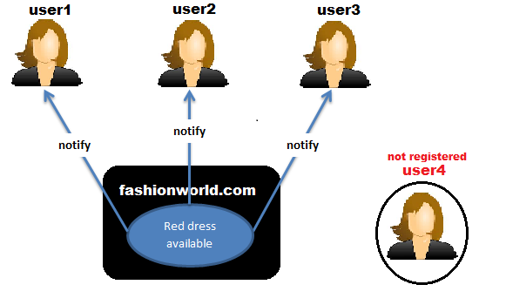
The Observer Pattern (Behavioral)
Defines a “one-to-many” dependency between objects so that when one object changes state, all its dependents are notified and updated automatically
Out of stock -> Register her email address -> Notify me
"Notify Me" button is an example of Observer Pattern.

Slide 4
All the users who registered for notification in the above case are Observers (user1, user2, user3).
The subject of their observation is Red Dress. So, Red Dress is Subject/Observable.
There is one Red dress but many users are interested in it.

Slide 5
Observer Pattern defines one to many relationship between Subject and Observers
When the state of dress changes from 'Out of stock' to 'in stock‘ all users are notified.
User4 is not registered hence he is not an observer in this case.
If User1 gets her registration removed later, she will not remain an Observer in that case and will not be notified.
Observers subscribe for a Subject.
Observers can unsubscribe at any time

Slide 6
Observer Pattern - Example
a
b
c
b
Observers
x
60
30
10
a
c
y
50
30
20
z
80
10
10
a b c
a = 50%
b = 30%
c = 20%
Subject
requests, modifications
change notification

Slide 7
Observer Pattern - Key Players
Subject
has a list of observers
Interfaces for attaching/detaching an observer
Observer
An updating interface for objects that gets notified of changes in a subject
ConcreteSubject
Stores “state of interest” to observers
Sends notification when state changes
ConcreteObserver
Implements updating interface

Slide 8
Observer Pattern - UML
observers
Subject
Observer
Attach(Observer)
Detach(Observer) Notify()
Update()
for all o in
observers {
o -> Update()}
ConcreteObserver
Update()
observerState =
subject->GetState()
subject
ConcreteSubject
observerState
SetState()
GetState()
return subjectState
subjectState
Notes:
Related Patters:
Mediator – an object in the middle intercepts all update requests and broadcasts them to other objects
Singleton – A “single” subject object instance can be implemented with a Singleton

Slide 9
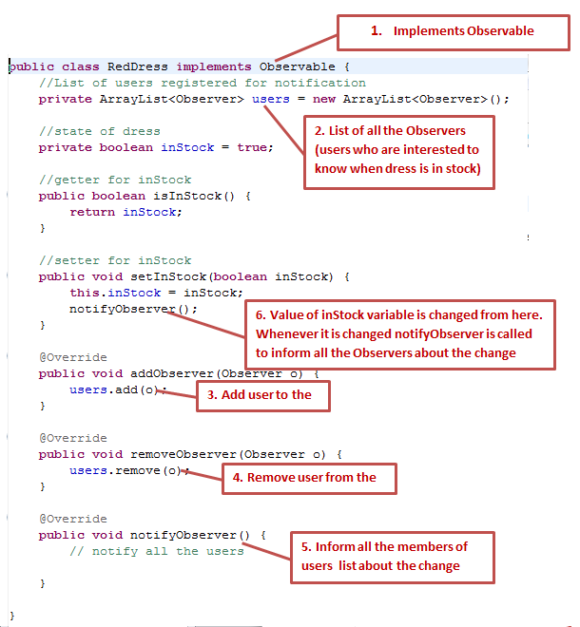
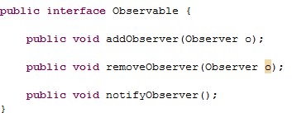
Observable is the Subject.

Slide 10
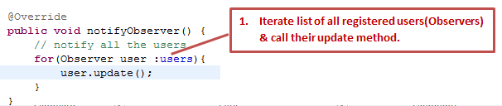

Slide 11

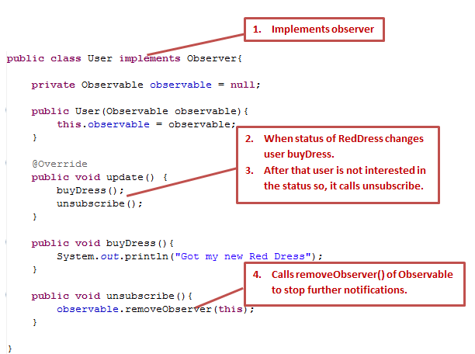

Slide 12
Observer Pattern - Advantages
It supports the principle of loose coupling between objects that interact with each other. Observers can be added/removed at any point of time.
It allows sending data to other objects effectively without any change in the Subject or Observer classes
Support for broadcast communication. Subject doesn’t need to know its receivers.

Slide 13
Observer Pattern - Disadvantages
If a subject has many direct and indirect observers, it will take a lot of time to notify all observers.
There is no corresponding mechanism to let the observer know how the observed object changes, but only to know that the observed object has changed.
Another issue is memory management because the subject will hold all the references of all the observers. If we do not unregister the object, it can create the memory issue.
Notes:
Some Safeguards:
Mapping subjects to observers (subjects store references)
Have state-setting operations of notifications of updates
- May be expensive and inefficient
Make clients notify of changes at the right time
- Clients have an added responsibility and forget
Dangling references to deleted subjects should be avoided
Subject state should be self-consistent before notification
Avoid observer-specific update protocols
Push – subject sends observers detail at will
Pull – observers ask for detail after notification is sent
Specify modifications of interest explicitly
Encapsulate complex update semantics

Slide 14
Strategy Pattern (Behavioral)
Problem: How do you allow the algorithm that is used to solve a particular problem to be easily and dynamically changed by the client?
Solution: Define a family of algorithms with a similar interface. Each algorithm provides a different strategy for solving the problem at hand. Encapsulate each algorithm, and let the client select the strategy to be used in any situation.
It's used to manage algorithms, relationships and responsibilities between objects.

Slide 15
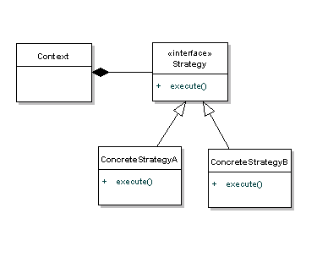
UML Diagram
Context is composed of a Strategy. The context could be anything that would require changing behaviours - a class that provides sorting functionality perhaps.
The Strategy is simply implemented as an interface, so that we can swap ConcreteStrategy’s in and out without effecting our Context.

Slide 16
When to use Strategy Pattern
The Strategy pattern is to be used where you want to choose the algorithm to use at runtime.
The Strategy pattern provides a way to define a family of algorithms, encapsulate each one as an object, and make them interchangeable.
A good use of the Strategy pattern would be saving files in different formats, running various sorting algorithms, or file compression.

Slide 17
File Compression Tool – zip or rar
//Strategy Interface
public interface CompressionStrategy {
public void compressFiles(ArrayList<File> files);
}
public class ZipCompressionStrategy implements CompressionStrategy {
public void compressFiles(ArrayList<File> files) {
//using ZIP approach
}
}
public class RarCompressionStrategy implements CompressionStrategy {
public void compressFiles(ArrayList<File> files) {
//using RAR approach
}
}

Slide 18
Context
public class CompressionContext {
private CompressionStrategy strategy;
//this can be set at runtime by the application preferences
public void setCompressionStrategy(CompressionStrategy strategy) {
this.strategy = strategy;
}
//use the strategy
public void createArchive(ArrayList<File> files) {
strategy.compressFiles(files);
}
}

Slide 19
Client
public class Client {
public static void main(String[] args) {
CompressionContext ctx = new CompressionContext();
//we could assume context is already set by preferences
ctx.setCompressionStrategy(new ZipCompressionStrategy());
//get a list of files...
ctx.createArchive(fileList);
}
}

Slide 20
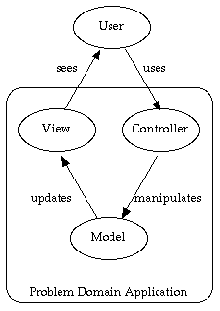
MVC Design Patterns
Model-View-Controller (MVC)
A collection of simpler patterns that are incredibly useful (a few patterns put together).
Most software developers find it useful
Using MVC, you think of the application in terms of these three modules -
Model : The core of the application.
Controller : The user interface presented to the user to manipulate the application.
View : The user interface which displays information about the model to the user.

Slide 21
Model
This maintains the state and data that the application represents. When significant changes occur in the model, it notifies all of its views
The Model's responsibilities
Provide access to the state of the system
Provide access to the system's functionality
Can notify the view(s) that its state has changed

Slide 22
View
The view's responsibilities
Display the state of the model to the user
Any object that needs information about the model needs to be a registered view with the model, so the model can notify the views that its state has changed
MVC decouples views and model by establishing a subscribe/notify protocol which is an example of the Observer design pattern
You can attach multiple views to the model without rewriting it

Slide 23
Controller
The controller's responsibilities
Accept user input
Button clicks, key presses, mouse movements, slider bar changes
Send messages to the model, which may in turn notify its observers
Send appropriate messages to the view
In Java, listeners are controllers (KeyListener, MouseListener, TextListener, WindowListener, …)
An ActionListener object and its actionPerformed method is a Controller

Slide 24
View-Controller
A view uses an instance of a Controller subclass to implement a particular response strategy.
To implement a different strategy, simply replace the instance with a different kind of controller.
The view-controller relationship is an example of the Strategy design pattern!

Slide 25
Model View Controller (MVC)
MVC decouples the model, view, and controller from each other to increase flexibility and reuse.
The intent of MVC is to keep neatly separate objects into one of three categories
Model
The data, the business logic, rules, strategies, and so on
View
Displays the model and usually has components that allows user to edit change the model
Controller
Allows data to flow between the view and the model
The controller mediates between the view and model

Slide 26
MVC
MVC was originally developed to map the traditional input, processing, output roles into the GUI realm:
Input --> Processing --> Output
Controller --> Model --> View
Model-View-Controller ("MVC") is the recommended architectural design pattern for interactive applications
Most Web-tier application frameworks use some variation of the MVC design pattern.

Slide 27
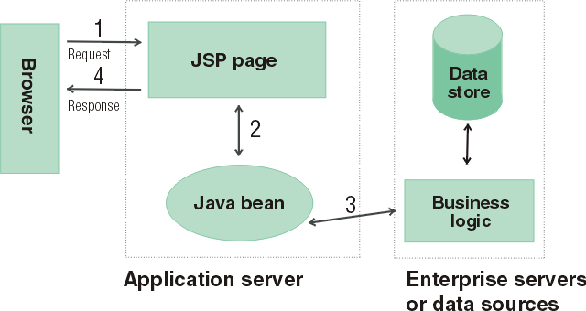
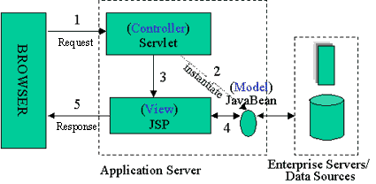
Java Server Pages
Model 2 Architecture to serve dynamic content
Model: Enterprise Beans with data in the DBMS
JavaBean: a class that encapsulates objects and can be displayed graphically
Controller: Servlets create beans, decide which JSP to return, do the bulk of the processing
View: The JSPs generated in the presentation layer (the browser)

Slide 28
Architectural Pattern
MVC is often thought of as a software design pattern. However, MVC encompasses more of the architecture of an application than is typical for a design pattern. Hence the term architectural pattern may be useful (Buschmann, et al 1996), or perhaps an aggregate design pattern.

Slide 29
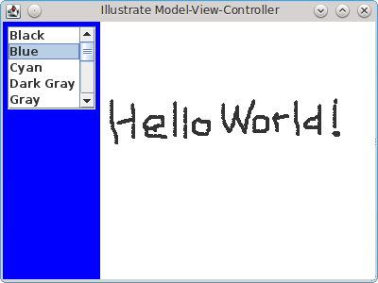
MVC Example
JList example and the mouse drawing example using a JPanel

Slide 30
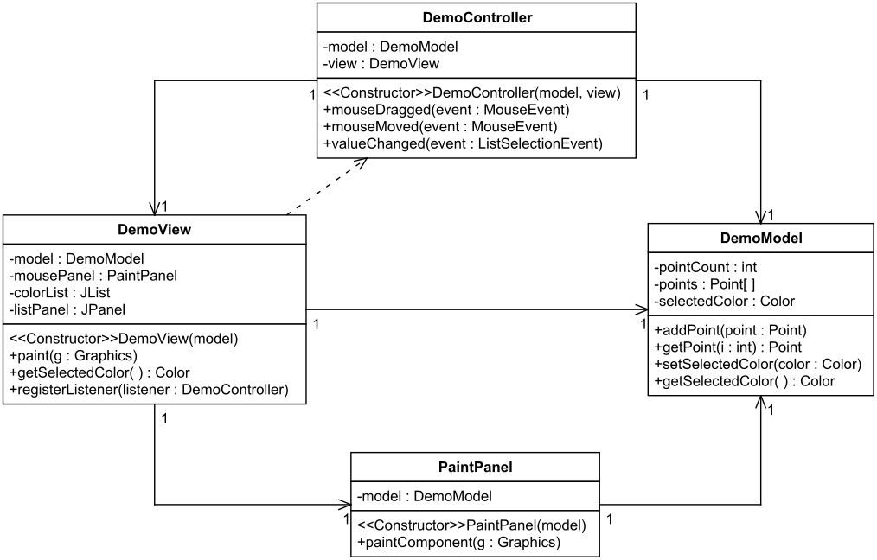

Slide 31
The UML diagram shows unidirectional associations because, for example, DemoController has a DemoModel attribute, but not vice versa. A dependency is shown from DemoView to DemoController because DemoView's registerController method has a DemoController parameter.

Slide 32
DemoModel
A DemoModel object has instance variables for storing an array of Points and a color. [A Point object has instance variables x and y that can be directly accessed, e.g., point.x and point.y.]
DemoModel also has methods for updating and accessing the points and the color.

Slide 33
public class DemoModel {
private int pointCount;//The number of points
private Point[] points;
private Color selectedColor;
public DemoModel() {
pointCount = 0;
points = new Point[10000];
selectedColor = Color.CYAN;
}
public void addPoint(Point point) {}
public Point getPoint(int i) {}
public void setSelectedColor(Color color) {}
public Color getSelectedColor() {}
}

Slide 34
DemoController
A DemoController object has instance variables for a DemoModel and a DemoView.
DemoController implements the MouseMotionListener interface (mouseDragged and mouseMoved method) and the ListSelectionListener interface (valueChanged method).

Slide 35
public class DemoController implements ListSelectionListener, mouseMotionListener {
private DemoModel model;
private DemoView view;
public DemoController(DemoModel model, DemoView view) {
this.model = model;
this.view = view;
}
public void mouseDragged(MouseEvent event) {}
public void mouseMoved(MouseEvent event) {}
public void valueChanged(ListSelectionEvent event) {}
}

Slide 36
DemoView
A DemoView object has instance variables for the window's components, plus two class constants for the color selection.
DemoView is a subclass of JFrame. The constructor organises the window, and the methods help to coordinate with the controller and the model.

Slide 37
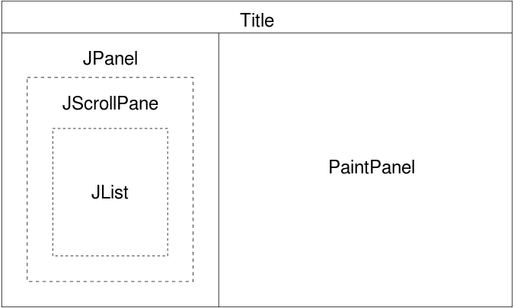

Slide 38
public class DemoView extends JFrame {
private DemoModel model;
private PaintPanel mousePanel;
private JList colorList;
private JPanel listPanel;
private static final String[] colorNames = {"Black", "Blue", ...};
private static final Color[] colors = {Color.BLACK, Color.BLUE,
...};

Slide 39
public DemoView(DemoModel model) {
super("Illustrate Model-View-Controller");
this.model = model;
/* CENTER: Add a panel that the user can draw on. */
mousePanel = new PaintPanel(model);
mousePanel.setBackground(Color.WHITE);
add(mousePanel, BorderLayout.CENTER);
/* WEST: Add a list so the user can select a color. */
listPanel = new JPanel();
add(listPanel, BorderLayout.WEST);
colorList = new JList(colorNames);
colorList.setVisibleRowCount(5);
colorList.setSelectionMode(ListSelectionModel.SINGLE_SELECTION);
listPanel.add(new JScrollPane(colorList), BorderLayout.CENTER);
} // end constructor
}

Slide 40
PaintPanel
PaintPanel implements the rest of the view.
It is used to draw the points that the user has drawn.
PaintPanel extends JPanel and overrides the paintComponent method to draw the points.

Slide 41
public class PaintPanel extends JPanel {
private DemoModel model;
public PaintPanel(DemoModel model) {
this.model = model;
} // end PaintPanel constructor
public void paintComponent(Graphics g) {}
}

Slide 42
public void registerListener(DemoController listener) {
colorList.addListSelectionListener(listener); mousePanel.addMouseMotionListener(listener);
}
public Color getSelectedColor() {}
public void paint(Graphics g) {}

Slide 43
DemoMVC
The DemoMVC class holds the main method that starts the application.
DemoModel implements the model part of the application.
DemoController implements the controller part of the application.
DemoView and PaintPanel implement the view part of the application.

Slide 44
public class DemoMVC {
/**
* main method starts the application
*/
public static void main(String[] args) {
DemoModel model = new DemoModel();
DemoView view = new DemoView(model);
DemoController controller = new DemoController(model, view);
// register controller as the listener
view.registerListener(controller);
// start it up
view.setDefaultCloseOperation(JFrame.EXIT_ON_CLOSE);
view.setSize(400, 300);
view.setVisible(true);
}
}
http://www.cs.utsa.edu/~cs3443/mvc-example.html

Slide 45
MVC Benefits
Clarity of design
easier to implement and maintain
Modularity
changes to one doesn't affect other modules
can develop in parallel once you have the interfaces
Multiple views
games, spreadsheets, powerpoint, …

Slide 46
Spring Framework (IoC)

Slide 47
Framework

Slide 48
Patterns and Frameworks
There can be confusion between patterns and frameworks.
Patterns are more like small-scale or local architectures for architectural components or sub-components
Frameworks are partially completed software systems that may be targeted at a particular type of application. These are tailored by completing the unfinished components
Office building or student accommodation?

Slide 49
Framework vs Design Patterns
Different design levels, granularity, etc.
Frameworks
high level architectural
reuse of abstract design, algorithm and implementation
domain and programming language specific
Design patterns
lower level, more primitive
reuse of design expertise
more general and abstract
domain and language independent
patterns used for building frameworks

Slide 50
What is a Framework?
A framework can be defined as an integrated set of collaborating software artefacts (classes, objects and components) that provides a reusable architecture (generic features) common to a family of applications of a similar type. For e.g., a user interface framework provide support for interface event handling through a set of widgets that can be used to construct displays (layouts).
Frameworks support design reuse by providing a skeletal architecture that is implemented by a collection of concrete and abstract object classes and their interactions.

Slide 51
In brief
A framework dictates the architecture of your application.
Reusable software architecture which implements a generic solution to a generalised problem.
It provides common facilities to different application programs
Reuse of frameworks is the key to establishing reuse in OO systems
It will define the overall architecture, its partitioning into classes and objects, the key responsibilities thereof, how the classes and objects collaborate, and the thread of control.
Reused and extended by applications programmer, who customises it for particular purpose.

Slide 52
Spring
Spring framework is an open source Java platform that provides comprehensive infrastructure support for developing robust Java applications very easily and very rapidly.
The most popular application development framework for enterprise Java
Millions of developers around the world use Spring to create
high performing,
easily testable, and
reusable code

Slide 53
Spring

Slide 54
Main Characteristics of Spring
Spring is the most popular application development framework for enterprise Java.
Spring is organized in a modular fashion. Even though the number of packages and classes are substantial, you have to worry only about the ones you need and ignore the rest.
Spring makes use of some of the existing technologies like several ORM frameworks, logging frameworks, JEE, Quartz and JDK timers, and other view technologies.
Testing an application written with Spring is simple because environment-dependent code is moved into this framework. Furthermore, by using JavaBean style POJOs, it becomes easier to use dependency injection for injecting test data.

Slide 55
Main Characteristics of Spring (Cont.)
Spring's web framework is a well-designed web MVC framework, which provides a great alternative to web frameworks such as Struts or other over-engineered or less popular web frameworks.
Lightweight IoC containers tend to be lightweight, especially when compared to EJB containers, for example. This is beneficial for developing and deploying applications on computers with limited memory and CPU resources.

Slide 56
Difference between API and Framework
An API is interface to some functions/methods (the front-end code) in a library that you can call to perform tasks for you - the interface to the library. Libraries, are also set of codes which provides common and reusable functionalities. Framework is a collection of patterns and libraries to help with building an application. In Framework, you can add your codes to solve a problem in a particular domain.
The main difference between a framework and API/library is that a framework employees an Inversion of Control (IoC) between itself and its clients. A framework embodies some abstract design, with more behaviour built in. In order to use it you need to insert your behaviour into various places in the framework either by subclassing or by plugging in your own classes. The framework's code then calls your code. For this reason, frameworks are often said to abide by the Hollywood Principle "Don't call us, we'll call you.".

Slide 57
Two Key Concepts of Spring
IoC (Inversion of Control)
AoP (Aspect oriented Programming)

Slide 58
What is the Inversion of Control
Inversion of control (IoC) is a design principle in which custom-written portions of a code receive the control from a generic framework. An architecture with this design inverts control as compared to traditional programming in which, the code that expresses the purpose of the program calls into reusable libraries to take care of generic tasks, but with inversion of control, it is the framework that calls into the custom, or task-specific, code.
Also called Dependency Injection

Slide 59

IoC
The consumer class X needs to consume the class Y to accomplish something. This is a very obvious example.
But, does X really need to know that it uses Y?
Isn’t it enough that X knows that it uses something that has the behavior, the methods, the properties, etc., of Y without knowing who actually implements the behavior?

Slide 60
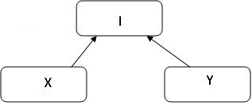
class Y implements interface I and class X uses I. An interesting thing is though class X still uses class Y through interface I, X doesn’t know that it uses Y, it just knows that it uses something that implements I. Right now, it’s Y, but it could be A, B, or C that implements interface I.
This way we are reducing the dependency of X over Y.

Slide 61
What is dependency?
When class X uses a method of class Y or class Y as a whole, class X has some level of dependency over class Y.
Dependency may extend to several levels. X uses Y, Y uses A and B, A uses C, and more. This way this chain goes on and on.
The problem with this is if we have any change in these classes, it may spawn to multiple classes.
The solution to this dependency problem is to define a loose relation between classes.
One way to achieve this is the Inversion of Control pattern. This pattern uses Dependency Injection to eliminate tight coupling between objects.

Slide 62
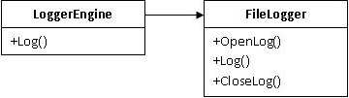
IoC Example
We have a class called LoggerEngine which is used for logging messages. It has a method called Log which receives a string object as an argument and logs it into a file using another class named FileLogger.

Slide 63
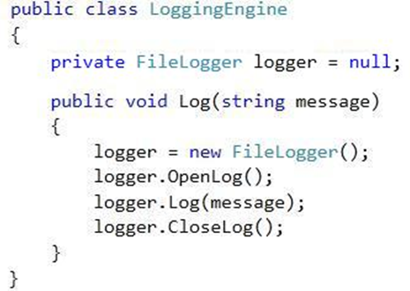

Slide 64
Notice the above code in which the Log method creates an instance of the FileLogger class and then logs the message using its own Log method.
What matters is, the dependency of the LoggerEngine class over the FileLogger class.
We can solve this by creating an abstract definition of the behavior in FileLogger that LoggerEngine needs in the form of an interface ILogger and making the Log method use an instance of ILogger instead of an instance of FileLogger.

Slide 65
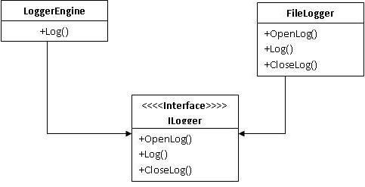
Now LoggerEngine no longer knows about the FileLogger class.
It just uses an instance of the ILogger interface of which FileLogger
is one of many possible implementations.

Slide 66
Here we need a way for LoggerEngine to get an instance of ILogger at runtime without knowing about the concrete implementation.
There are a couple of ways to do that.

Slide 67
Constructor Injection
The object reference would get passed to the constructor of the
Business Class LoggerEngine.
Step-1 Create an Interface:
public interface ILogger
{
void OpenLog();
void CloseLog();
void Log(string message);
}
Step-2 Implement an interface to the FileLogger class.
public class FileLogger implements ILogger
{
}

Slide 68
Step-3 Make a reference of the interface in the LoggerEngine class.
public class LoggingEngine
{
private ILogger logger = null;
public LoggingEngine(ILogger logger)
{
this.logger = logger;
}
public void Log(string message)
{
logger.OpenLog();
logger.Log(message);
logger.CloseLog();
}
}

Slide 69
Step-4 Create a third party class, which creates an instance of all these objects.
public class IoCClass
{
ILogger logger = null;
public string FileName { get; set; }
public void WriteLogUsingConstructorInjection(string message)
{
logger = new FileLogger(FileName);
LoggingEngine cEngine = new LoggingEngine(logger);
cEngine.Log(message);
cEngine = null;
}
}

Slide 70
Step-5 Use this third party class at the client side.
class Program
{
static void Main(string[] args)
{
string fileName = "C:\Windows\Temp\AppLog.log";
IoCClass obj = new IoCClass() { FileName = fileName };
//Constructor Injection
obj.WriteLogUsingConstructorInjection("Hi, how r u?");
Console.Read();
}
}

Slide 71
Other Injection
Setter injection
Interface injection

Slide 72
Benefits of Inversion of Controls
We can reduce the dependency between objects and can design more flexible systems.
We can isolate our code at the time of unit testing.

